Slide 1
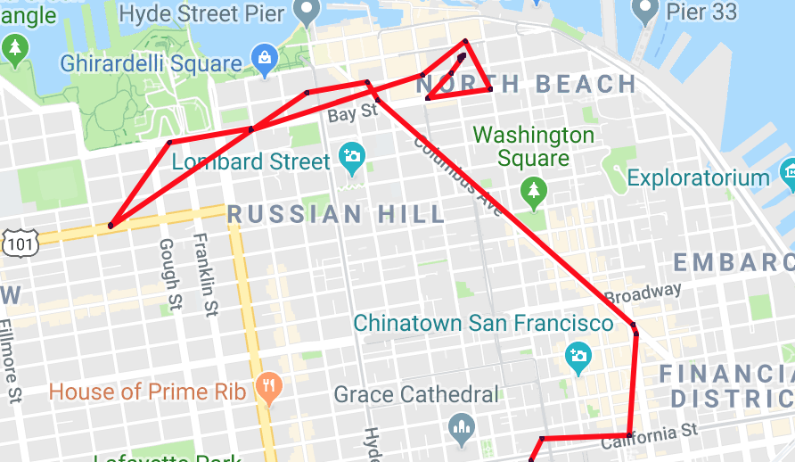
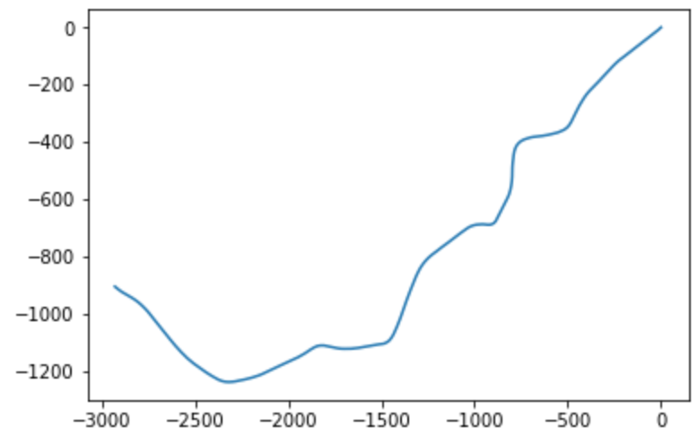
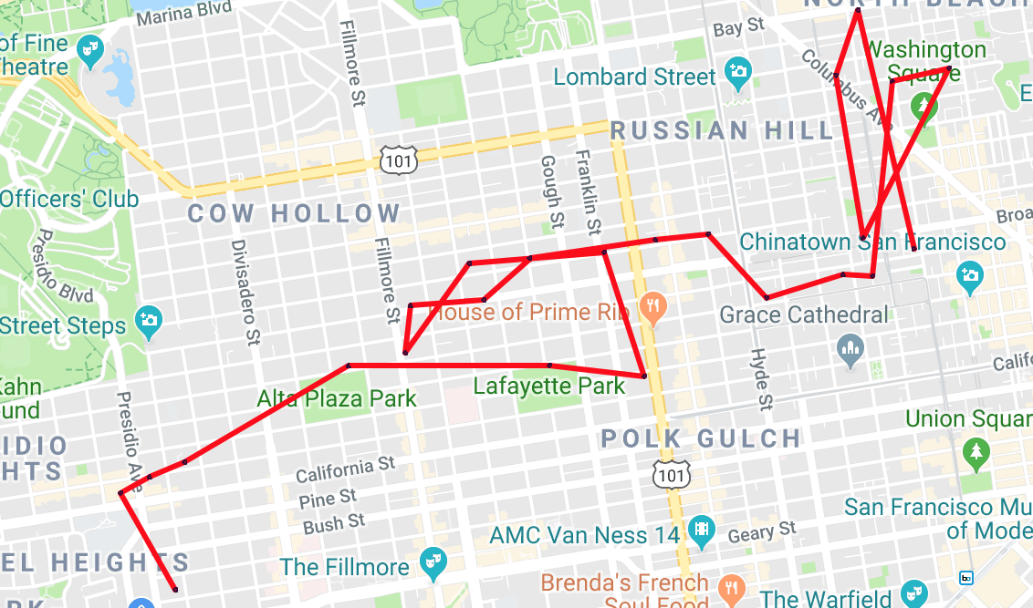
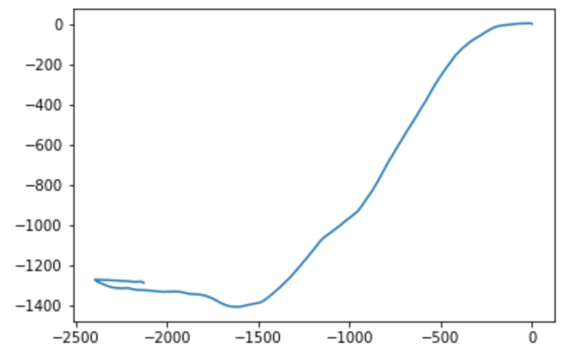
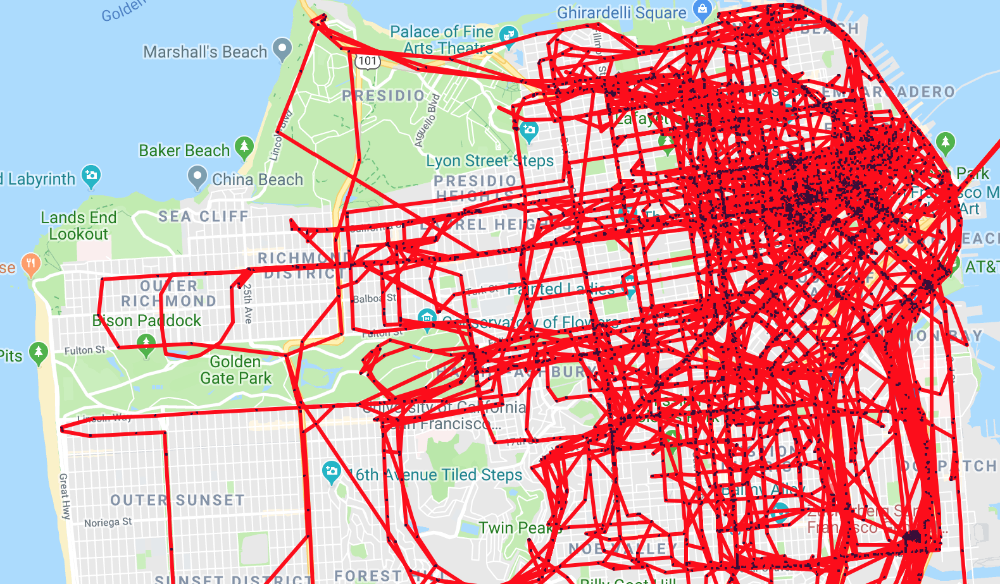
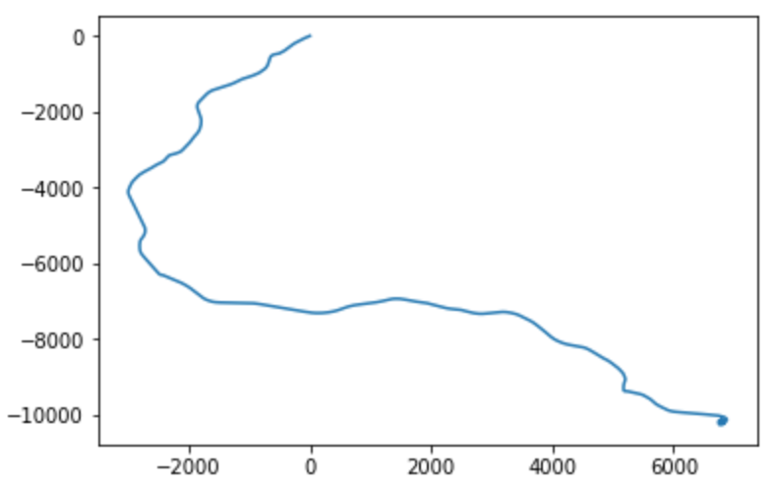
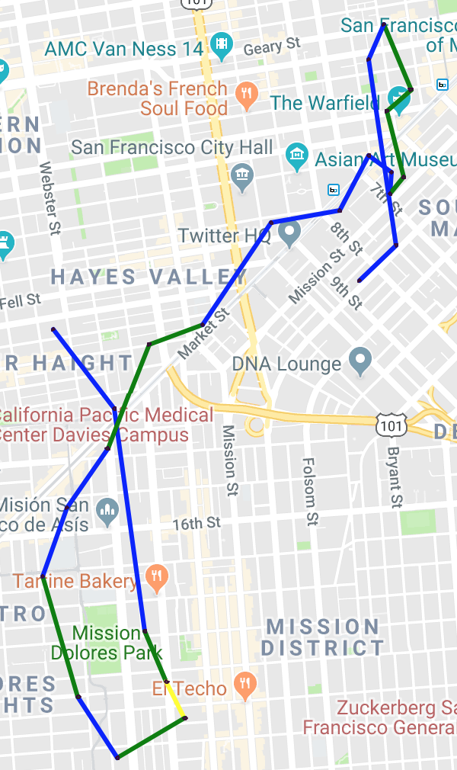
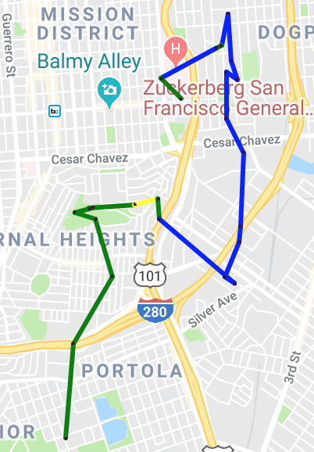
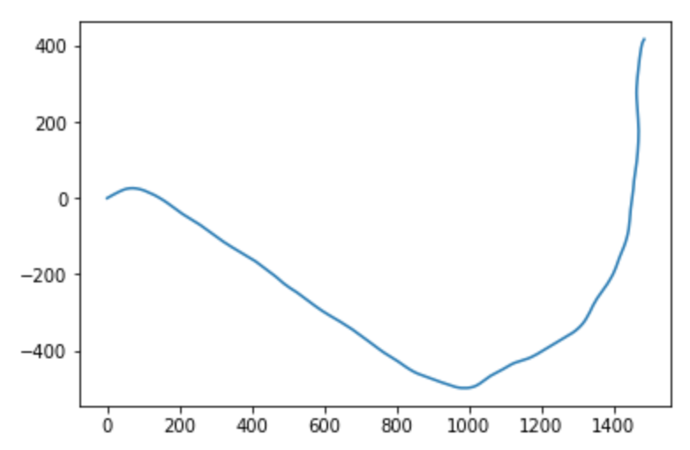
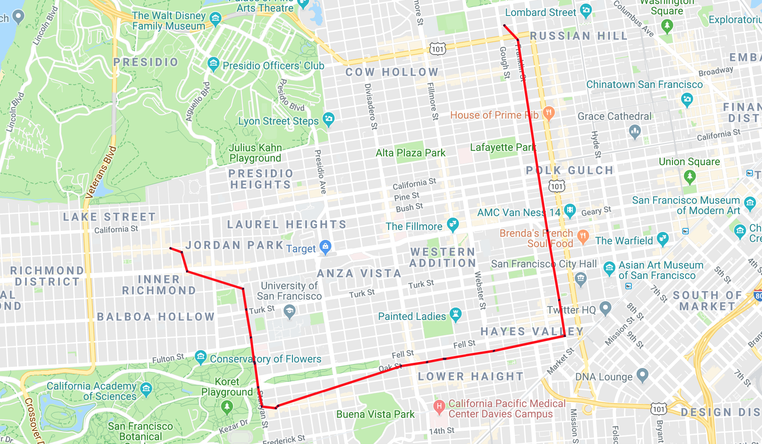
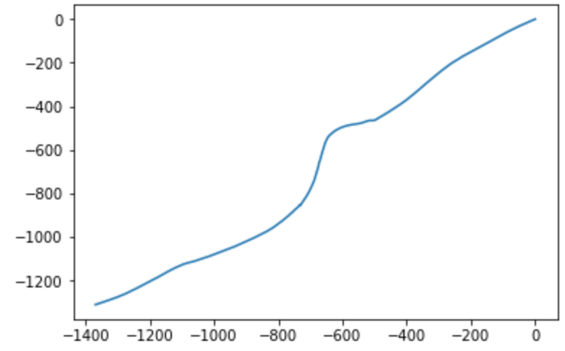
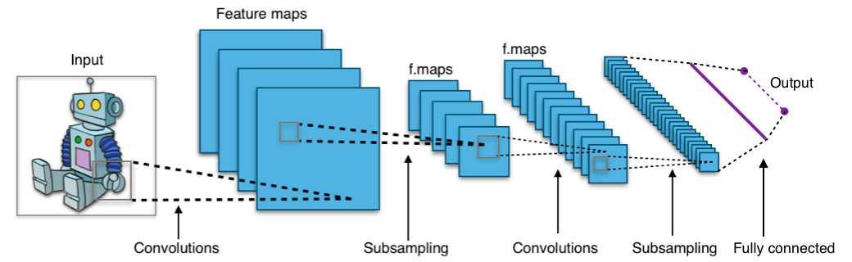
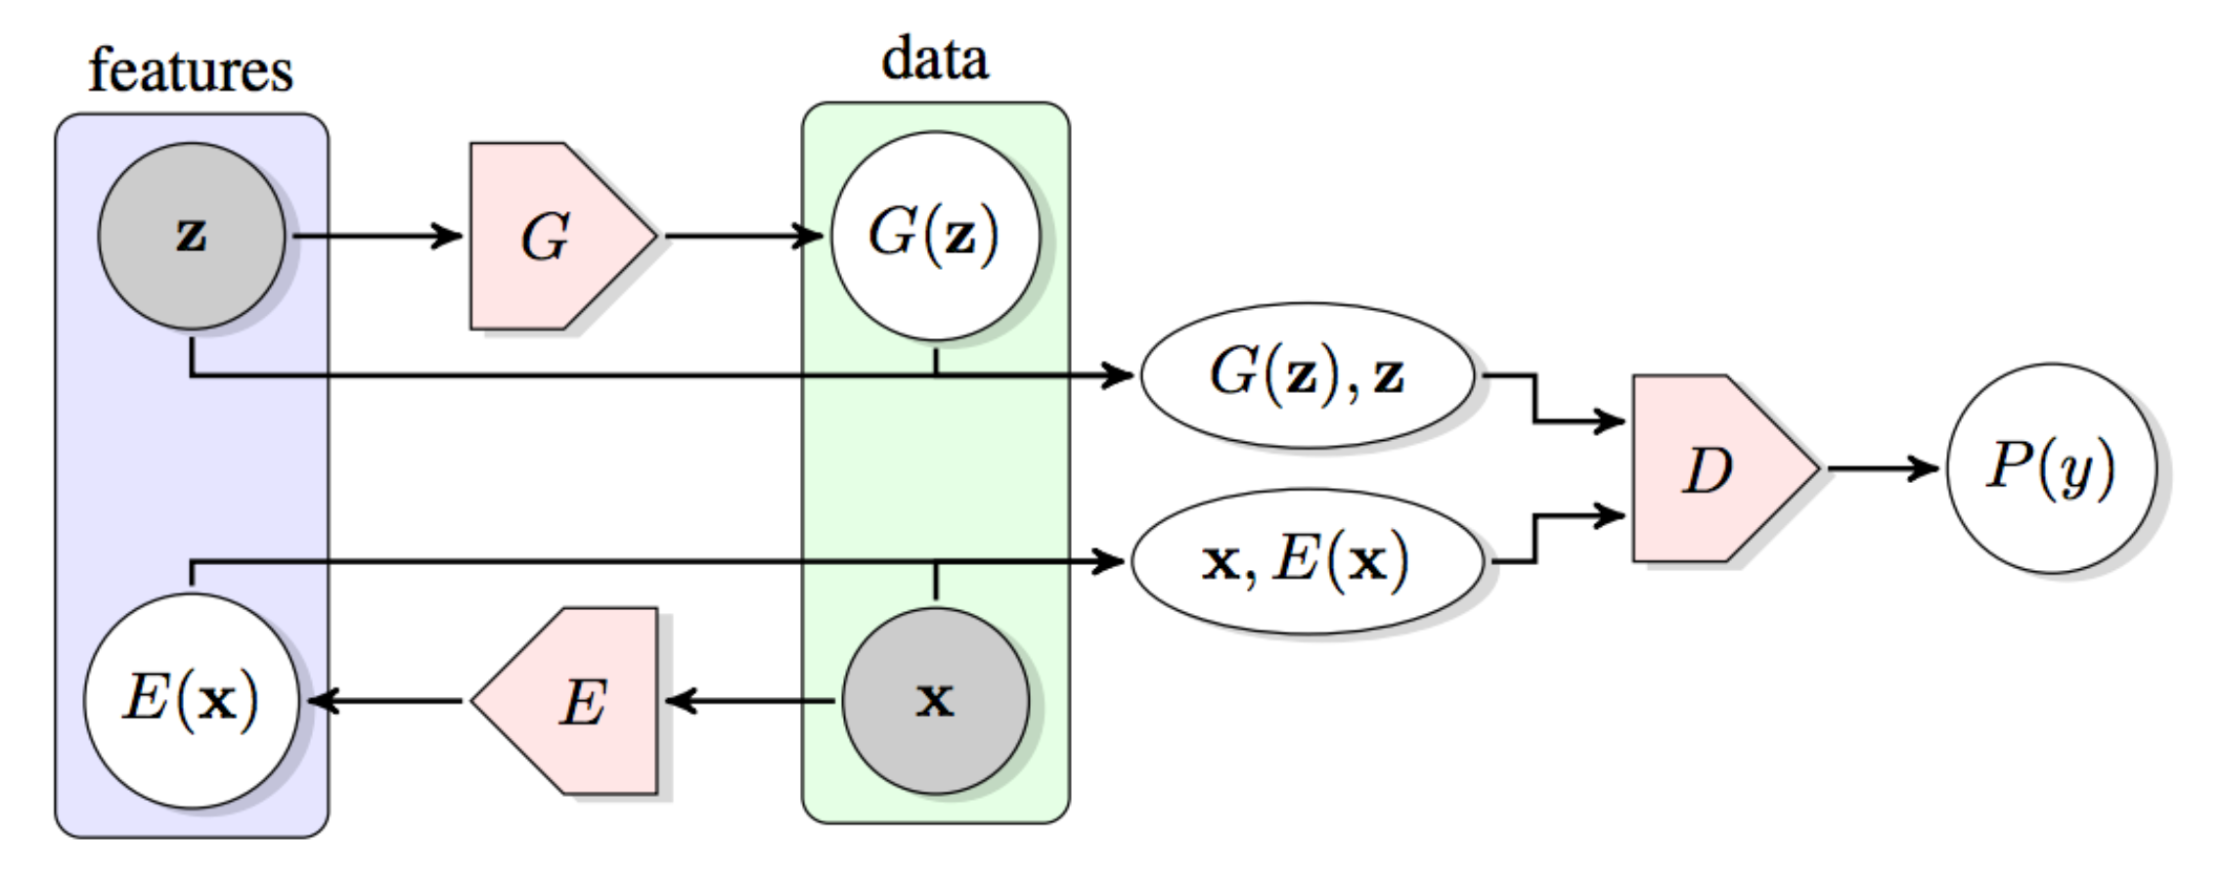
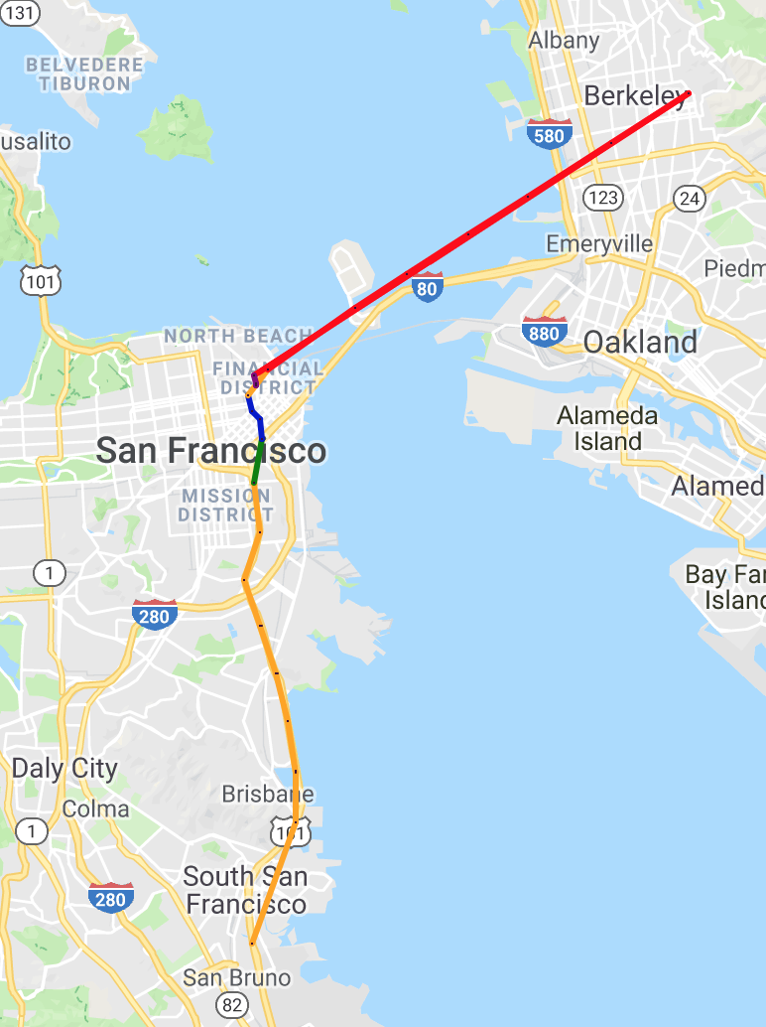
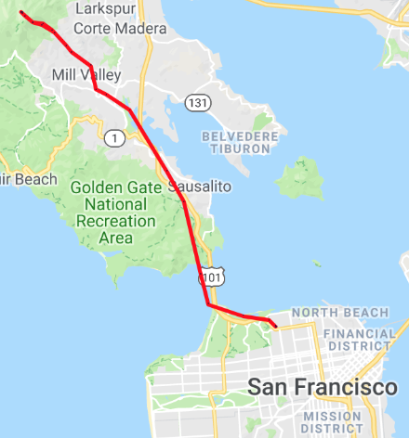
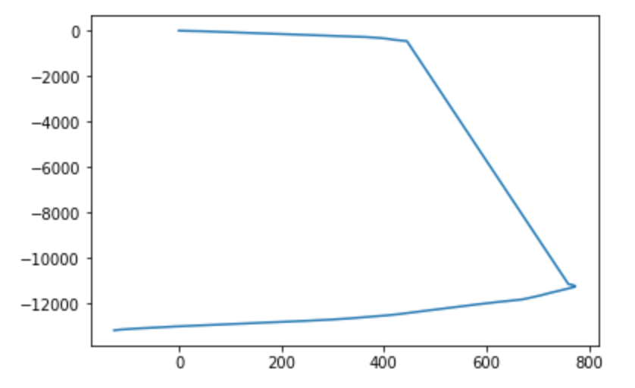
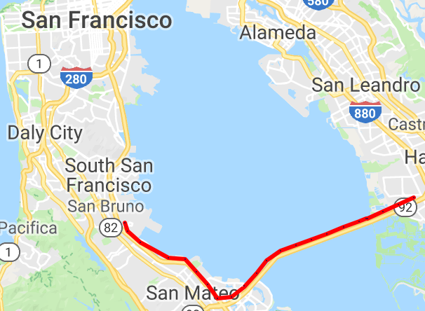
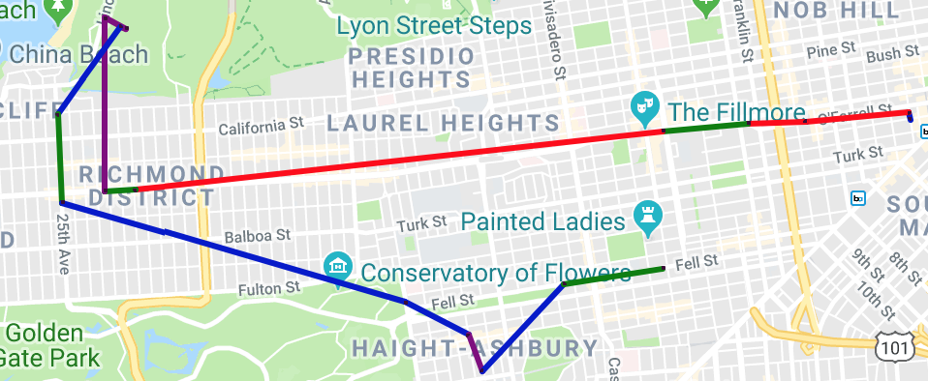
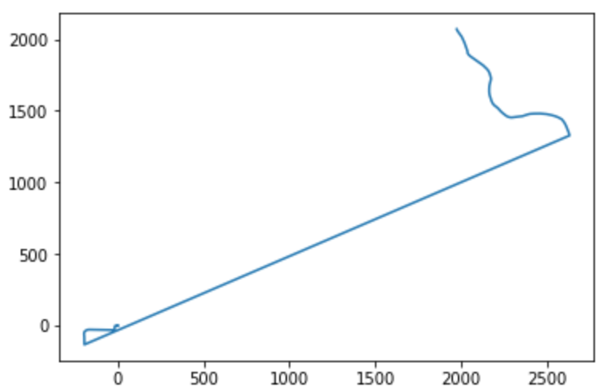
Scalable Gunshot Detection Systems with Convolutional Neural Networks
Alex Morehead¹, Lauren Ogden², Gabe Magee³, Ryan Hosler⁴, George Mohler⁴
¹Department of Computer Science, Mathematics, & Physics, Missouri Western State University; ²Department of Computer Science, Columbia University;
³Department of Computer Science, Pomona College; ⁴Department of Computer and Information Science, IUPUI School of Science
Introduction
Identifying Gunshots
Real or Fake?
Many cities with gunshot detection systems depend
on expensive systems that rely on humans differentiating between
gunshots and non-gunshots, such as ShotSpotter®. Thus, a
scalable gunshot detection system that is low in cost and high
in accuracy would be advantageous for a variety of cities across
the globe, in that it would favorably promote the delegation of
tasks typically worked by humans to machines.
San Francisco Cabs
Kaggle: Axa Telematics
???
The Data
San Francisco Cabs
Kaggle: Axa Telematics
???
Full Data
???
Single Trip
Shown above are examples from the datasets we are using. The dataset on the left is GPS data from cabs in San Francisco. With this data, we identify a single “trip” as each set of 24 points, standardizing this trip size for the purpose of our BiGAN. On the right, is the telematics data. Since this data was sampled more frequently, we define the trip size as 200 points. The coordinates are in meters as opposed to GPS lat/long as in the cab data.
Gunshot Detection: Methodology
A convolutional neural network (CNN) was trained on a variety of sound data
to recognize gunshots. This model was then deployed to a Raspberry Pi Model 3 B+ with an SMS modem attached. The findings generated by this research project have the potential to expand the current state of knowledge regarding sound-based applications of CNNs, and while simultaneously reducing the amount of jobs that require human input, the results of this
project could very well increase the standards of safety for a city’s residents.
CNNs
Data Collection, Segmentation, & Augmentation | Training the Model | Testing the Model
??? | ??? | ???
Convolutional Neural Networks (CNNs) are neural networks designed to locate, model, and accurately predict patterns present in input data such as a colored image.
They do so by iteratively sliding over small regions of a given image and translating any inherent properties in a region to a proceeding layer in the network. This process is repeated up until output layer generates a response.
Gunshot Detection: Results
{Insert results here}
Spectrograms
Data used | Cabs: Coordinates Only | Cabs: Coordinates & Velocities | Kaggle: Velocities Only
Routes designated as anomalies are… | Long trips that are far from the city center. | Trips with speeds exceeding 100 mph, often drastic single point GPS errors. | Trips with large jumps between contiguous coordinates.
Visual Examples
Spectrograms are visual representations of the frequency and magnitude of sound over a specified span of time.
Donahue, J., Krähenbühl, P., & Darrell, T. (2016). Adversarial feature learning.
Generator (G) | Encoder (E) | Discriminator (D)
Converts noise to fake data. Goal is to create realistic data to fool discriminator. | Learns inverse of generator. Converts real data to encoding. | Distinguishes between (real data, encoding) pair and (random noise, fake data) pair.
Acknowledgements
We gratefully acknowledge the support of NSF grant REU 1659488 which provided this project’s research stipends, travel funds, and supply money.

